Slide 1
THE NETWORKING AND INTERCONNECTIVITY
MNC NETWORK
Mandik Goyal

Slide 2
INTRODUCTION
A multinational corporation (MNC) is usually a large corporation incorporated in one country which produces or sells goods or services in various countries. Two common characteristics shared by MNCs are their large size and the fact that their worldwide activities are centrally controlled by the parent companies.
We Need a Network in order to Communicate within Company Network
We Need Network to Access Company Resources.
A computer network is a group of computers that use a set of common communication protocols over digital interconnections for the purpose of sharing resources located on or provided by the network nodes.

Slide 3
Purpose
There are two Purpose:
(1) to give you an understanding of how networks, especially the Internet, work,
(2) to teach you how network programming works.

Slide 4
Objective
Build implementations of the Internet protocols

Slide 5
Non Functional Requirements
1. Performance Requirements
1.1 Processing time – Interactions with the Router which require processing, such as Finding Path to Other Host and requesting session, should take less that three milli seconds.
1.2 Response time – Over reasonably common internet connection speeds, the Router should respond to Host requests in less that one milli seconds
2. Capacity and scalability
2.1 Capacity- A Router can handle more than 250 request at a time. So Capacity is More.
2.2 Scalability-We can Scale a Network as per Business Requirement.

Slide 6
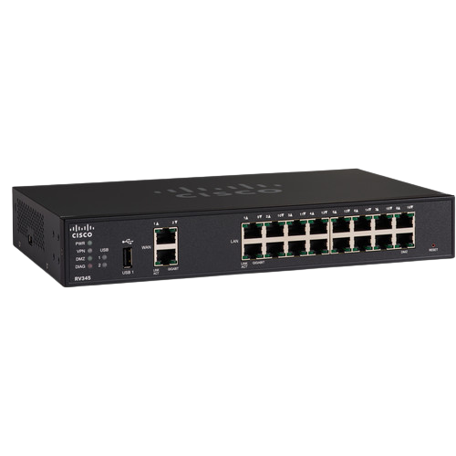
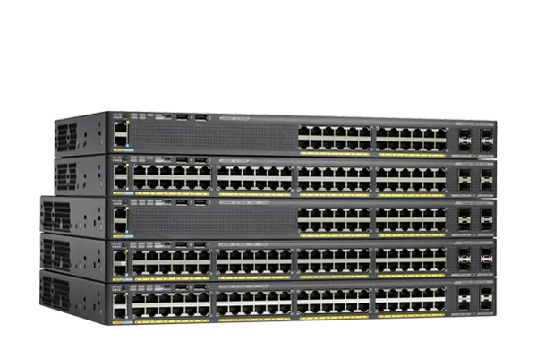
Router- Routers Are networking devices used to extend or segment networks by forwarding packets from one logical network to another. Routers are most often used in large inter-networks that use the TCP/IP protocol suite and for connecting TCP/IP hosts and local area networks (LAN s) to the Internet using dedicated leased lines.
Switch- Switches are a special type of hub that offers an additional layer of intelligence to basic, physical-layer repeater hubs. A switch must be able to read the MAC address of each frame it receives. This information allows switches to repeat incoming data frames only to the computer or computers to which a frame is addressed. This speeds up the network and reduces congestion.
.

Slide 7
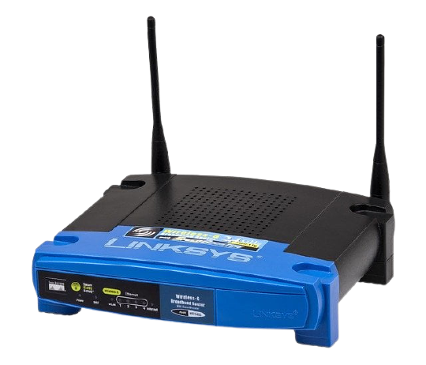
Gateway- A gateway is a device used to connect networks using different protocols. Gateways operate at the network layer of the OSI model. In order to communicate with a host on another network, an IP host must be configured with a route to the destination network. If a configuration route is not found, the host uses the gateway (default IP router) to transmit the traffic to the destination host. The default t gateway is where the IP sends packets that are destined for remote networks. If no default gateway is specified, communication is limited to the local network. Gateways receive data from a network using one type of protocol stack, removes that protocol stack and repackages it with the protocol stack that the other network can use

Slide 8
Functional Requirements
RIPV2- The Routing Information Protocol (RIP) is a distance-vector routing protocol, which employs the hop count as a routing metric. RIP prevents routing loops by implementing a limit on the number of hops allowed in a path from the source to a destination. The maximum number of hops allowed for RIP is 15. This hop limit, however, also limits the size of networks that RIP can support. A hop count of 16 is considered an infinite distance and used to deprecate inaccessible, inoperable, or otherwise undesirable routes in the selection process.
OSPF- Open Shortest Path First (OSPF) is a link-state routing protocol for Internet Protocol (IP) networks. It uses a link state routing algorithm and falls into the group of interior routing protocols, operating within a single autonomous system (AS). It is defined as OSPF Version 2 in (1998) for IPv4 The updates for IPv6 are specified as OSPF Version 3.OSPF is perhaps the most0 widely used interior gateway protocol (IGP) in large enterprise networks. IS-IS, another link-state dynamic routing protocol, is more common in large service provider networks. The most widely used exterior gateway protocol is the Border Gateway Protocol (BGP), the principal routing protocol between autonomous systems on the Internet. (DUAL distance vector)
OSPF is an interior gateway protocol that routes Internet Protocol (IP) packets solely within a single routing domain (autonomous system). It gathers link state information from available routers and constructs a topology map of the network. The topology determines the routing table presented to the Internet Layer which makes routing decisions based solely on the destination IP address found in IP packets. OSPF was designed to support variable-length subnet masking (VLSM) or Classless Inter-Domain Routing (CIDR) addressing models.

Slide 9
EIGRP- Enhanced Interior Gateway Routing Protocol - (EIGRP) is an open routing protocol loosely based on their original IGRP created by Cisco. EIGRP is an advanced distance-vector routing protocol, with optimizations to minimize both the routing instability incurred after topology changes, as well as the use of bandwidth and processing power in the router. Routers that support EIGRP will automatically redistribute route information to IGRP neighbors by converting the 32 bit EIGRP metric Update Algorithm (DUAL) work from SRI, which guarantees loop-free operation and provides a mechanism for fast convergence (Dijkstra link state)

Slide 10
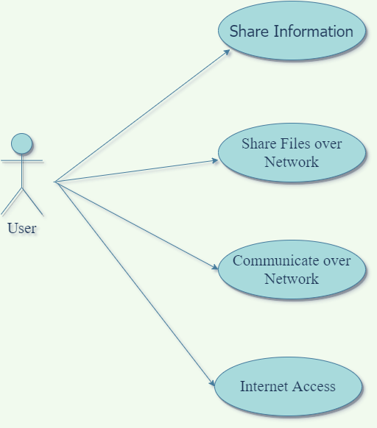
Use Case Diagram

Slide 11
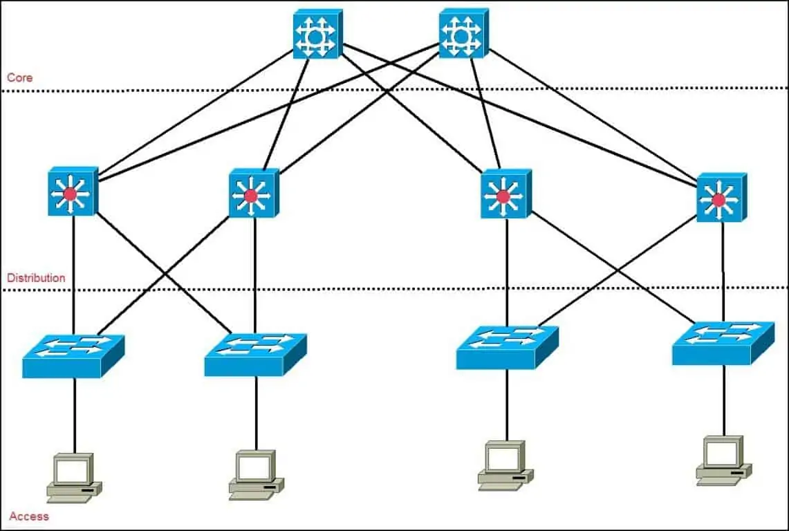
3 Layer Architecture
SW1
SW2
SW1
SW2
SW3
SW4
SW1
SW2
SW3
SW4
PC1
PC2
PC3
PC4

Slide 12
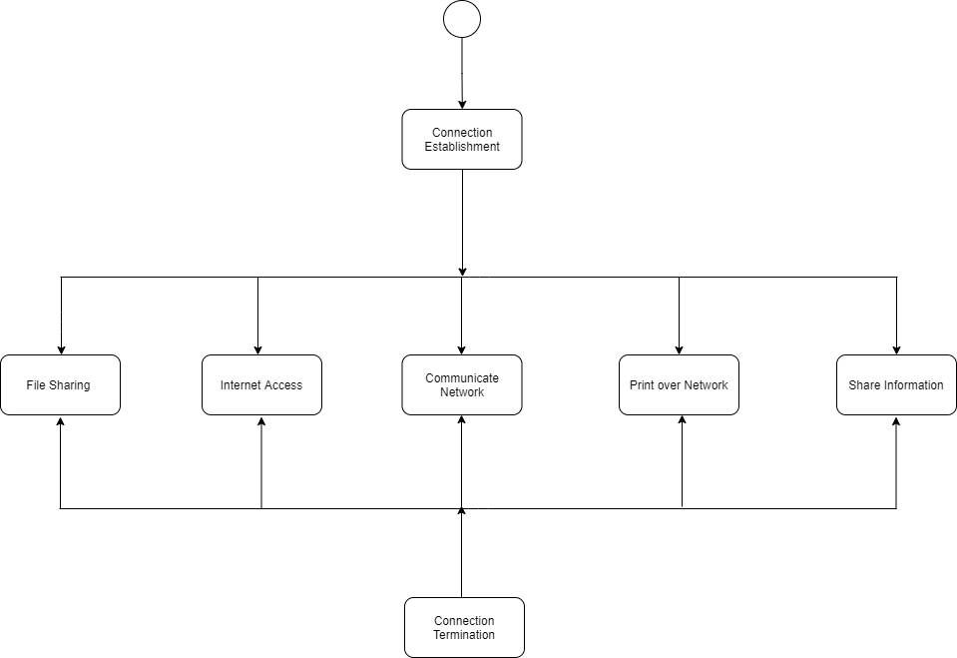
Activity Diagram

Slide 13
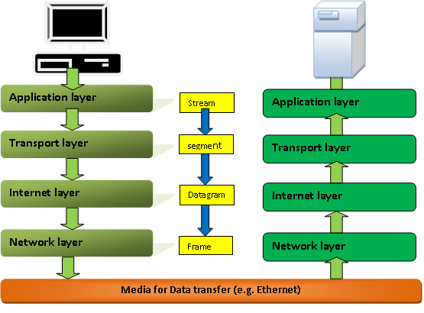
TCP/IP Model
PC
Server

Slide 14
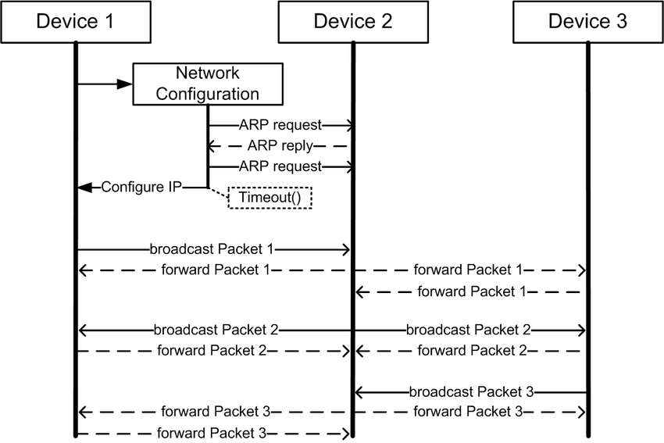
Sequence Diagram

Slide 15
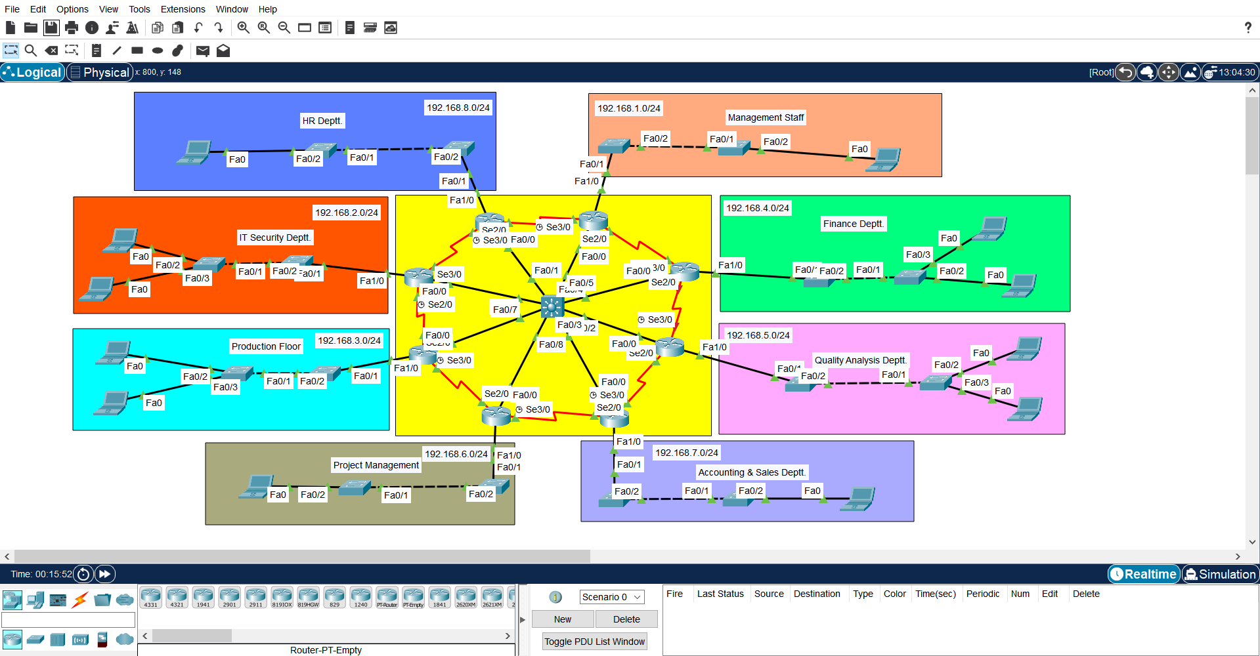
PROJECT SCENARIO

Slide 16
RESULT AND FUTURE SCORE
All the branches communicating with each other and access the internet via ISP using internet and network protocols.
Perhaps the greatest concern companies have in doing business over the Internet is the security risk. Hackers, denial-of-service (DoS) attacks, identity theft, and even
cyber-terrorism are very real dangers. In addition, you may wonder how to guarantee the performance and reliability of your Internet-based services. Or, you may not be certain that you have the resources and support needed to deploy and manage e-commerce services and processes.
The good news is that a sound network infrastructure can address all these issues. At the foundation of a robust e-commerce infrastructure are the routers and switches.
An integrated approach to routing and switching lets all workers—even those at different sites—have the same access to business applications, unified communications, and videoconferencing as their colleagues at headquarters.
Cisco lets you grow your network over time, adding features and functionality as you need them while ensuring complete investment protection. An added benefit of this integrated approach is that your IT personnel can centrally
manage the network from headquarters, which keeps staffing counts low.

Slide 17


